Slide 1
World Affairs Seminar 2020 Hunger in a World of Plenty
A Rotary District 6270 Initiative
Notes:
Introduce self

Slide 2
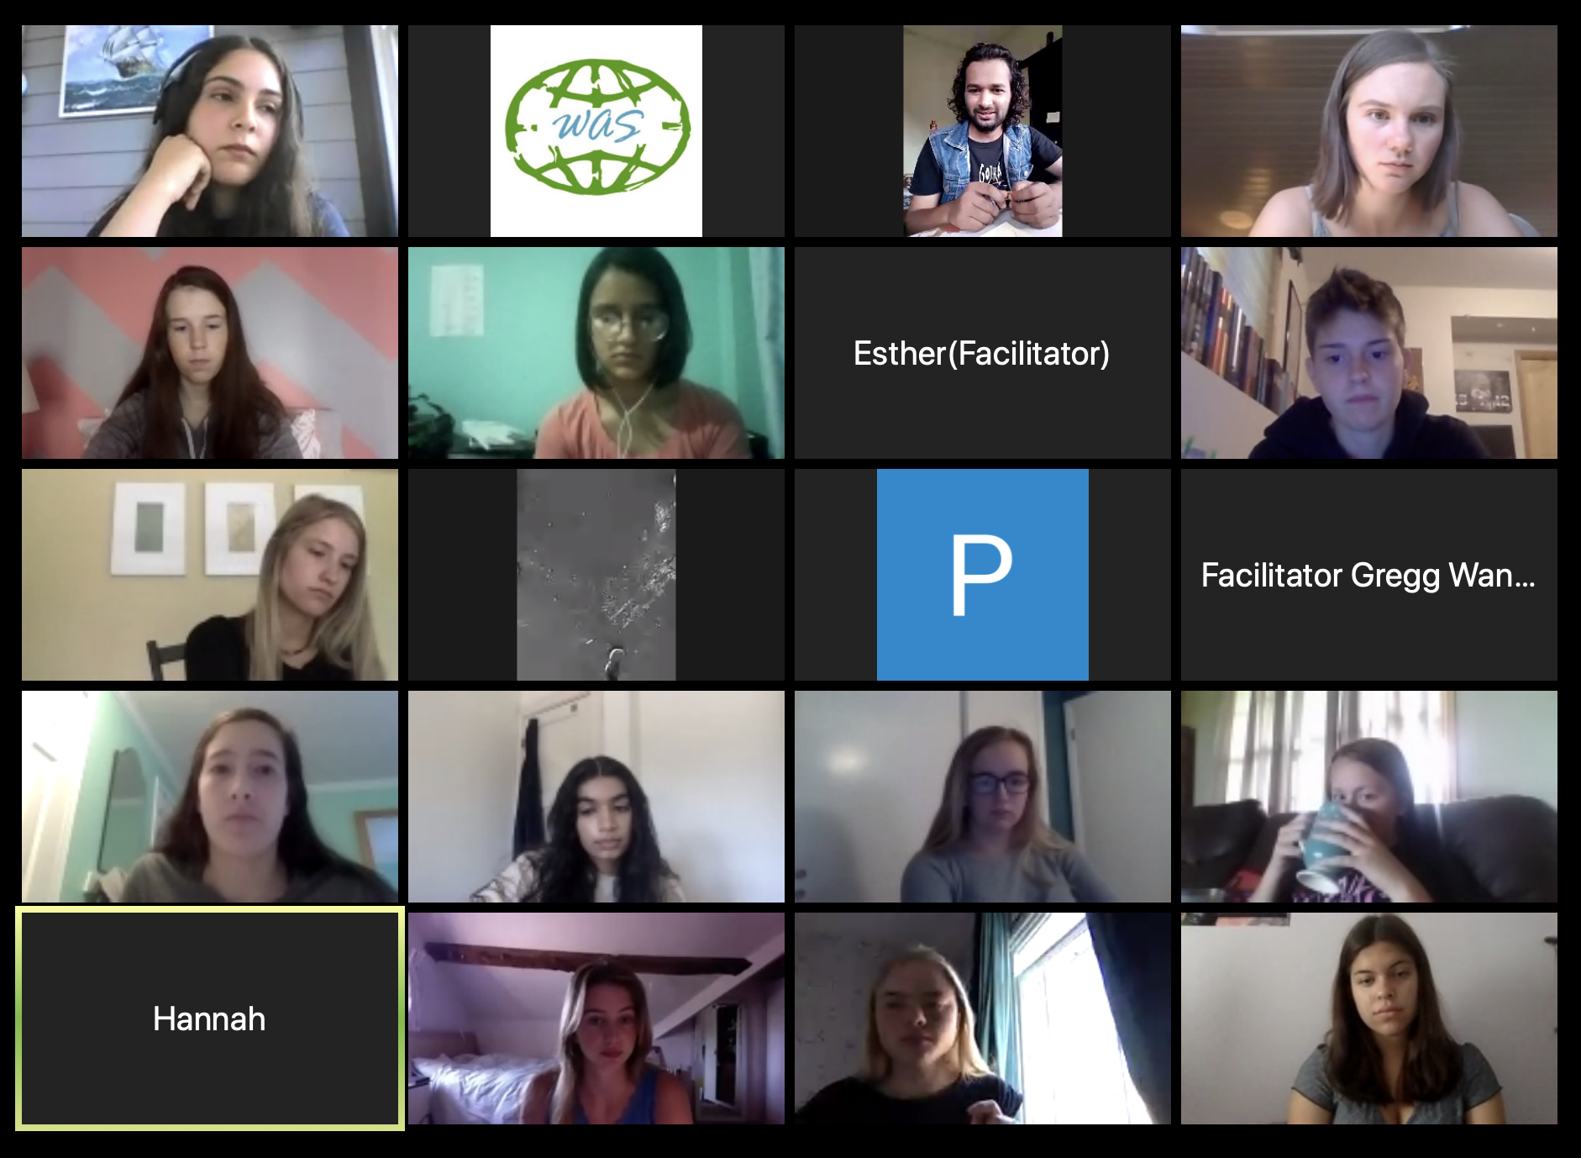
What is the World Affairs Seminar?
World Affairs Seminar (WAS) is a unique educational experience for high school students. We provide a forum for future international leaders to wrestle with the most perplexing global issues and problems.

Slide 3
World Affairs Seminar 2020
Theme: Hunger in a World of Plenty
Virtual Seminar: June 22 – 25, 2020
Food connects us all. But what happens when issues of access and distribution lead to a hungry planet? The 2020 World Affairs Seminar will explore these issues and more, leading delegates to collaborate and discover what they can do to shape the world and resolve these challenges as the future leaders of the world.

Slide 4
Keynote & Breakout Speakers
17 Keynote & Breakout Speakers

Slide 5
Daily Discussion Groups
Each discussion group session will have a different theme or topic, so be sure to pick discussion groups that interest you most or offer you the best chance to learn something new!
Hunger in the United States
Preparing to Address Hunger
Addressing Hunger Most Efficiently
Hunger and the Pandemic
Hunger Around the World
Nutrition and Public Health
Hunger and Migration
Tackling Hunger
Hunger and the Arts
Rethinking Hunger

Slide 6
Diplomacy Exercise
Scenario: Crisis in Our Oceans
Negotiating a Solution to Protect Our Food
The fish population off the coast of the Federated States of Hiroot is rapidly depleting due to overfishing. While Hiroot depends on fish for food and trade, it lacks the resources to effectively police its coastal waters. Recently, ships from the nearby country of Uzan have been spotted illegally fishing in Hiroot’s exclusive economic zone. A summit has been called with the Food and Agriculture Organization of the United Nations, the Global Oceans Fund, and the governments of Hiroot, Uzan, and the United States to discuss the problem.
In this hypothetical simulation, students will be assigned the roles of the U.S. Department of State and other key stakeholders as they negotiate to resolve this crisis in our oceans. The exercise will develop skills in critical thinking, collaboration, problem-solving, communication, and global competence.

Slide 7
My Highlights & What I Learned

Slide 8
World Affairs Seminar 2021
Urban Life in a Changing World
June 19 – 25, 2021
Preview!
For the first time in human history, more people live in cities and urban areas than in other environments. Some would say this is a natural course for humanity. Issues range from sanitation to allocation of resources, personal responsibility to one another and society and the customs and laws that govern our behavior and may impact our very existence.
Visit www.WorldAffairsSeminar.org/WAS2020 to learn more!

Slide 9
Questions?
A Rotary District 6270 Initiative

Slide 10
Thank you
for sponsoring
my attendance!
A Rotary District 6270 Initiative

Slide 11
Contact Information
World Affairs Seminar
10600 W. Mitchell Street
West Allis, WI 53214
Call: (414) 453-4984
Fax: (414) 431-0588
Email: contact@worldaffairsseminar.org
Find us on online:
www.WorldAffairsSeminar.org

